Slide 1
Machine Learning Model to Predict Car Price using Gradient Boosting

Slide 2
Team Members
Aman Khandelwal | U101116FCS007
Chinju Mary George | U101116FCS025
Shashwat Shah | U101116FCS112
Sagnik Mitra | U101116FCS188

Slide 3
Rationale of Work
Car Prediction has wide scope in automobile industry in helping customers know the prices of their desired car.
It also aids the organization or concern in determining the future goals for it and its plans and procedures to achieve it,

Slide 4
Objective of the project
The aim of this project is to build and deploy a Machine Learning Model that can predict the car price based on its features.

Slide 5
Workflow
Exploratory Data Analysis
Model Development
Deployment of the Model

Slide 6
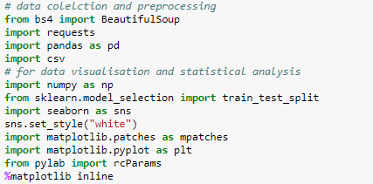
Libraries Used

Slide 7
Data Preprocessing and Cleaning
The raw data gathered is preprocessed in order to make it useful for visualization and training session.
We read the dataset into dataframes so that we can manipulate it easily.

Slide 8
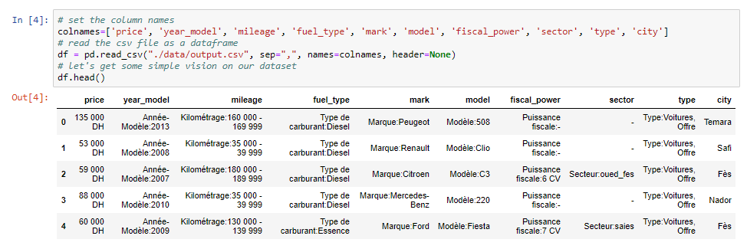

Slide 9
The first thing we did is to clean unwanted strings from the columns, then change it to the appropriate type since all of them are string values and finally dropped unwanted columns such as sector, type, fiscal_power.
One thing we have noticed is that there are some ads that were published without the price, so the first thing to do is to delete those rows.

Slide 10
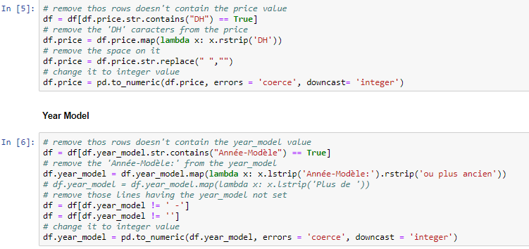

Slide 11
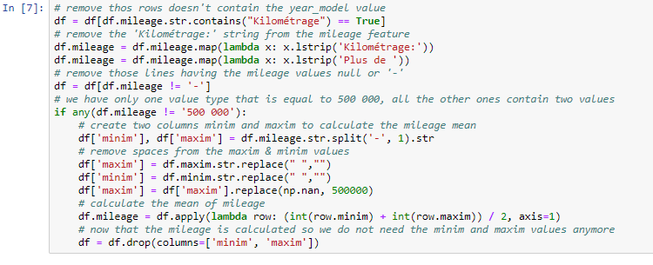
Feature Engineering

Slide 12
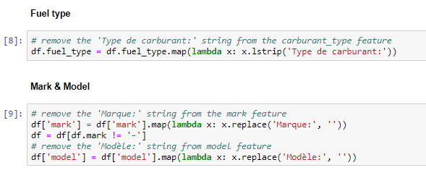

Slide 13

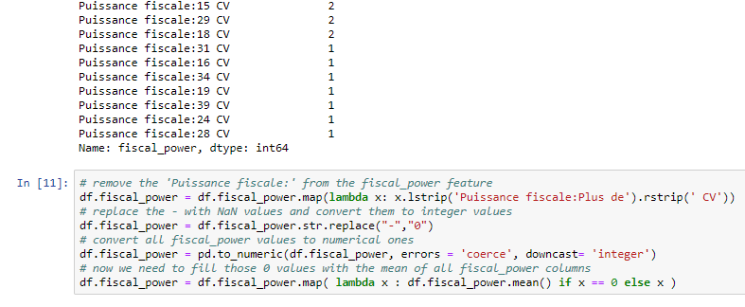

Slide 14
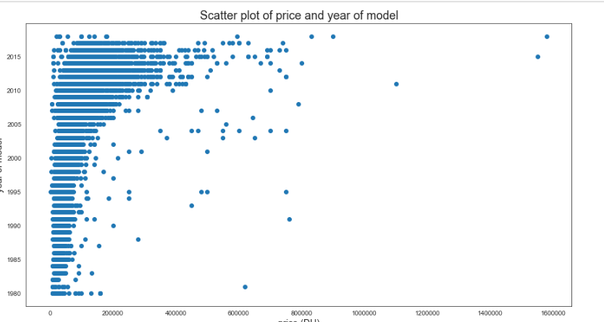
Exploratory Data Analysis and Visualization

Slide 15
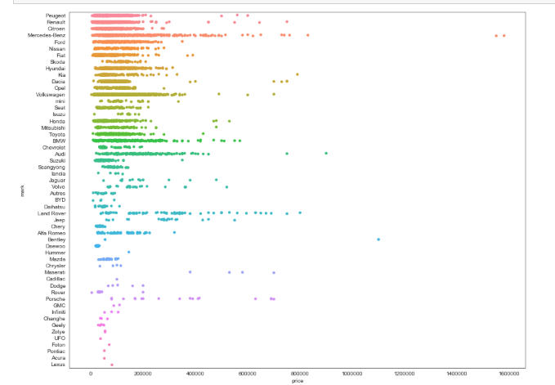
Price Distribution by mark

Slide 16
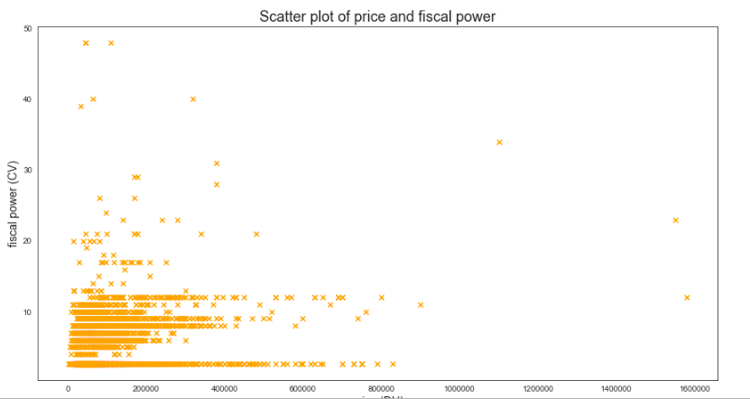
Scatter plot of Price and Fiscal Power

Slide 17
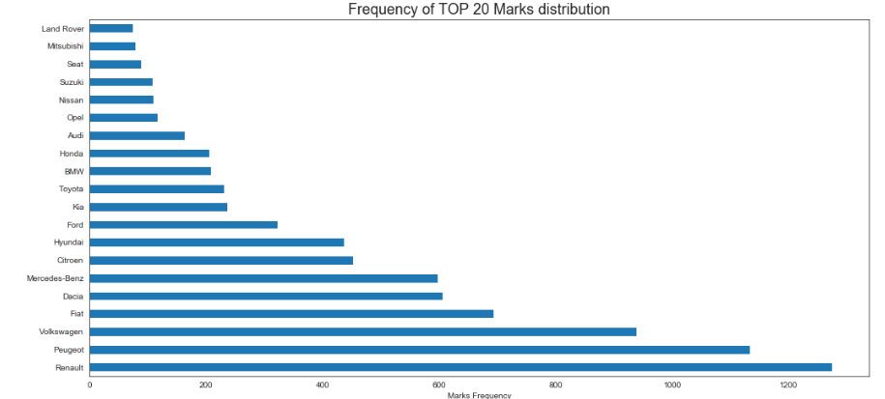
Top 20 Marks Distribution

Slide 18
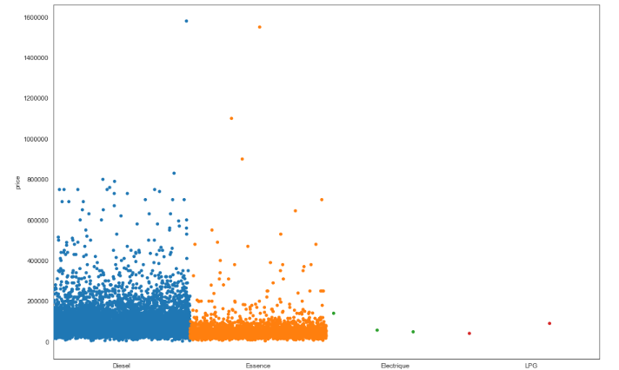
Price distribution by fuel type

Slide 19
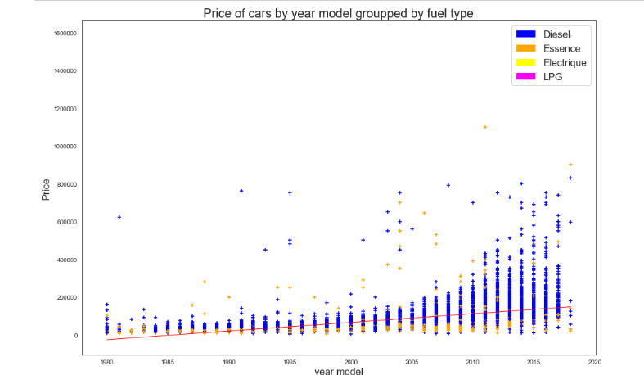
Price of Car vs Fuel Type

Slide 20
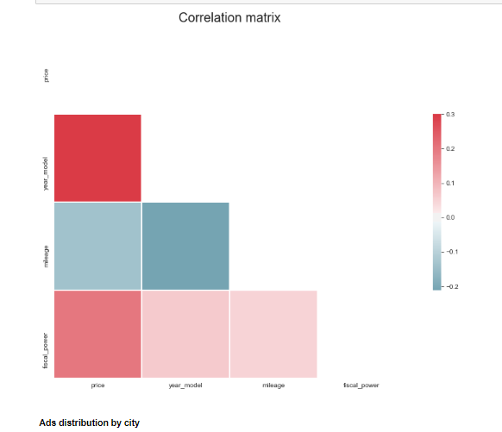
Correlation matrix

Slide 21
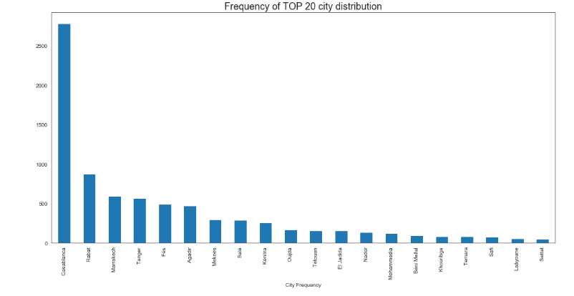
Ad Distribution by city

Slide 22
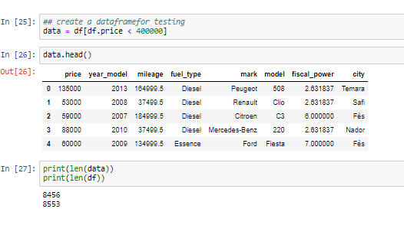
Data Modeling
KNN Regression

Slide 23
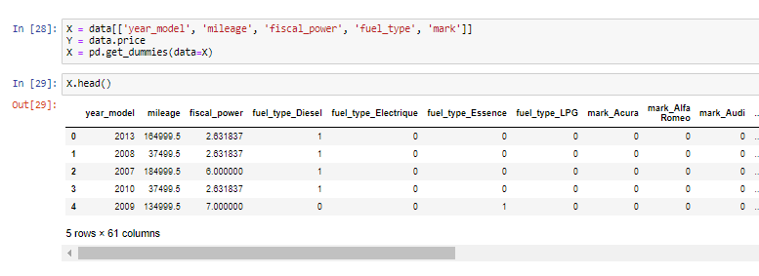
Dealing with Categorical Features

Slide 24
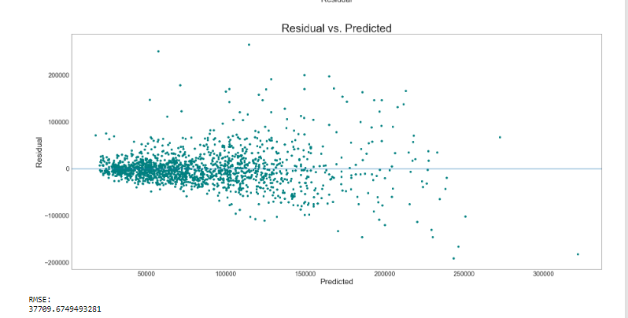
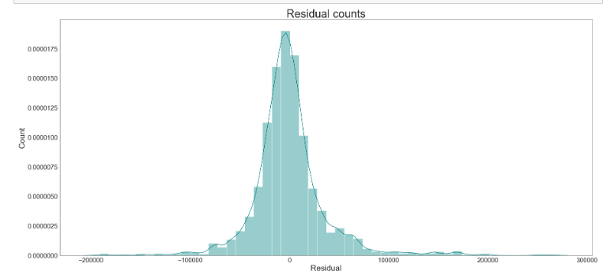

Data Splitting

Slide 25
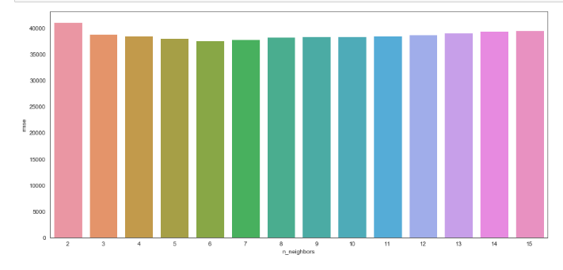
It appears that 6 nearest neighbors is the optimal number of neighbors.

Slide 26
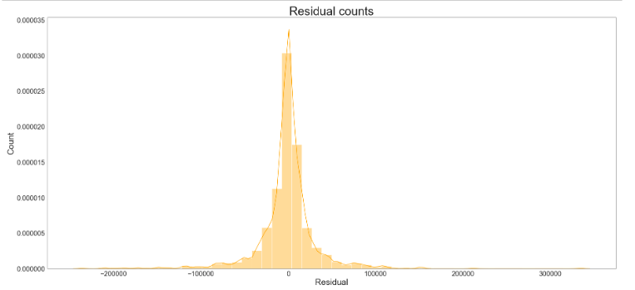
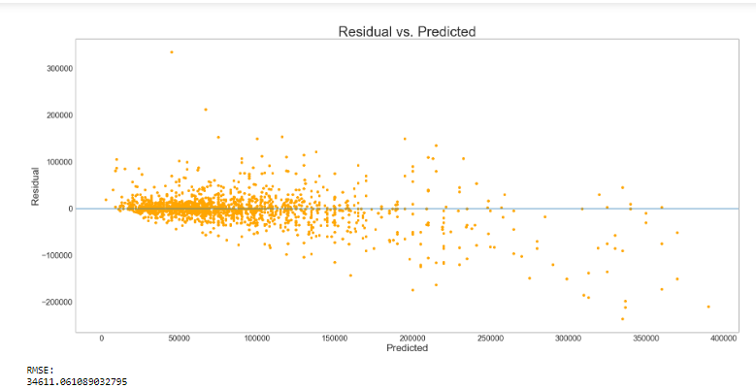

Decision Tree Regression

Slide 27
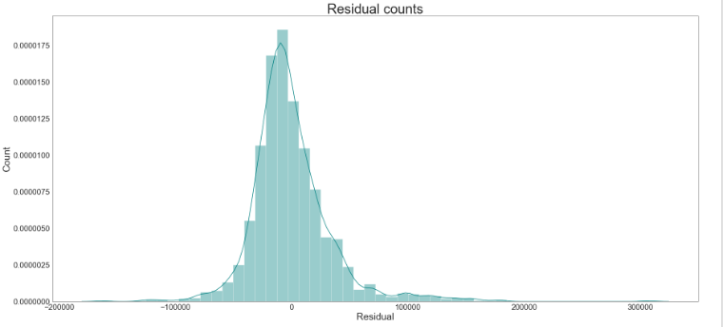
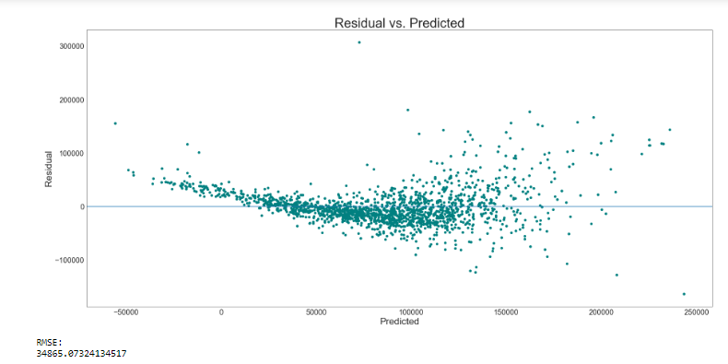

Simple Linear Regression

Slide 28
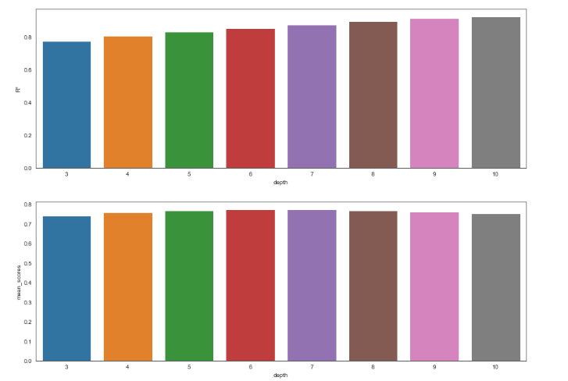
Boosting
Graph 1: depth vs R^2
Graph 2:depth vs Mean score

Slide 29
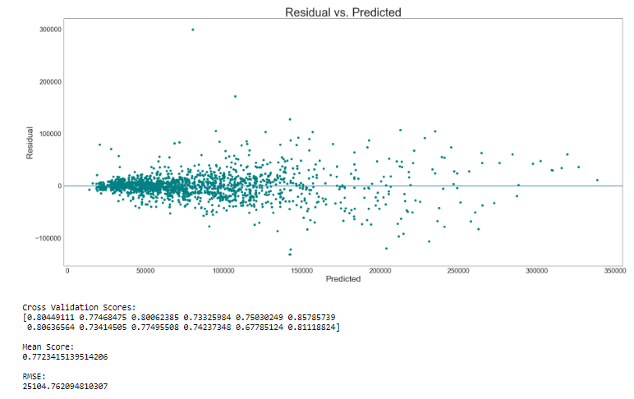

Slide 30
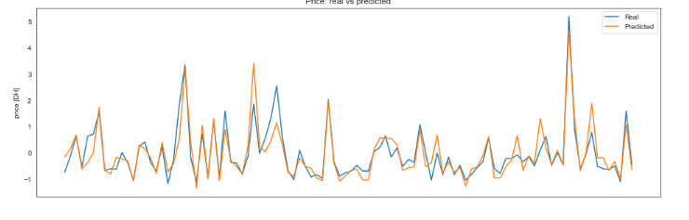
Real price vs Predicted price

Slide 31
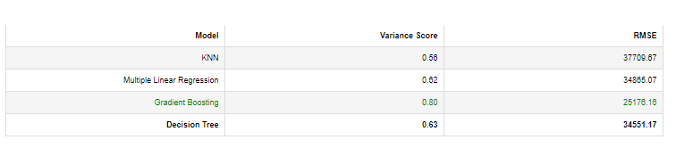
Model Evaluation
Gradient Boosting is seen as the best for the model.

Slide 32
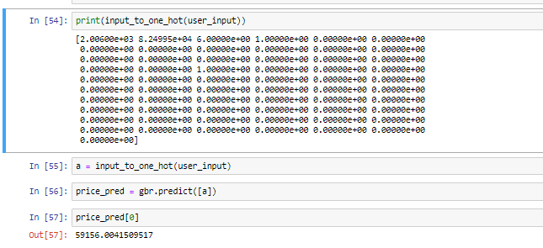
Transformation to One hot encoding

Slide 33
Difficulties Faced
Finding proper datasets
Training of model was time consuming.

Slide 34
Future Prospects
Predict an observation never seen before.
Creating the Flask web app
Deploy the app to Heroku

